Slide 1


GROUP 8
Online Shopping Database
Data Management and Database Design
Instructor – Simon Wang

Slide 2

Agenda
1
Database Design Document
2
Database ERD
3
Database Implementation
4
Reporting Views & Visualization
5
Conclusions
6
Q & A

Slide 3
Design Document - Database Purpose
1
Track and report customers retention and preference
2
Make efficient marketing plan
3
Improve profits and sales

Slide 4
Design Document - Business Problems
Provide information to improve profits and sales.
Allow staff to track customer order to make sure the items arrived on time and keep the customer satisfied.
Analyze data for administrative staff to make effective decision when purchase inventory items.
Collect and analyze customers feedback to improve the quality and efficiency of customer service.

Slide 5

Database ERD
ERD
DOCUMENT LINK

Slide 6
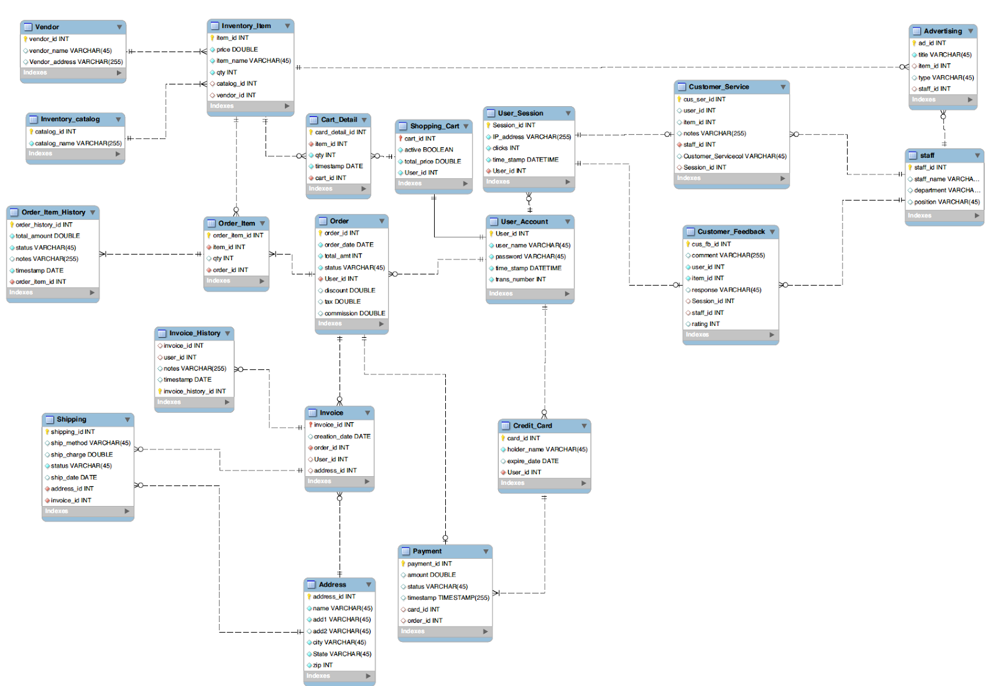

Slide 7
Database Implementation
Create Database Online Shopping
Create Tables(20 tables)
Input Data(every table has 10 data)

Slide 8
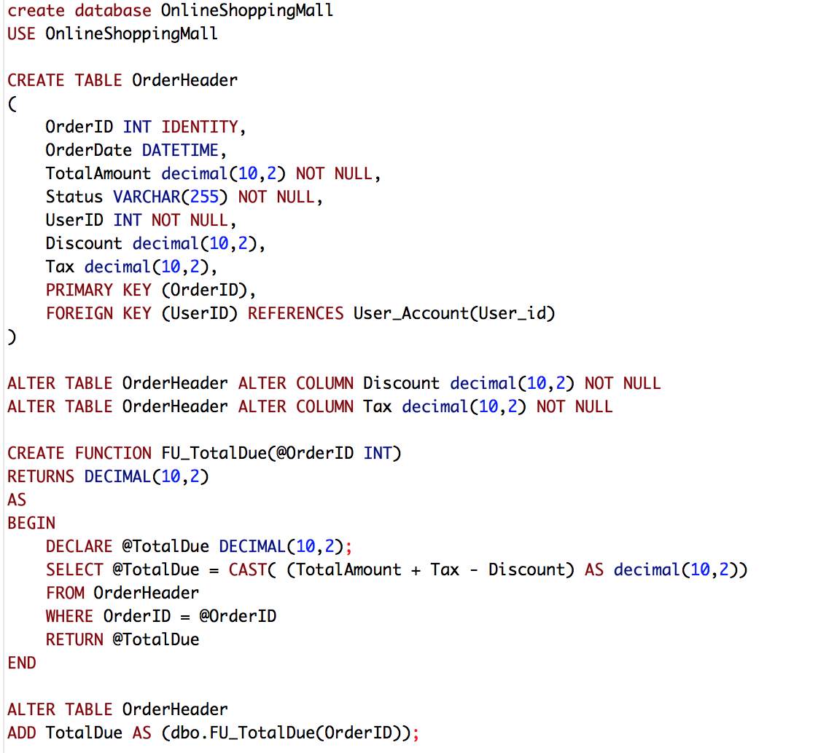
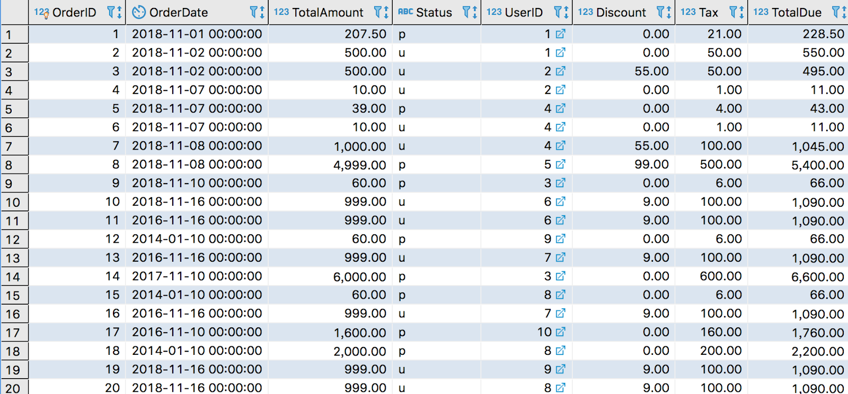
Database Implementation – Computed Column

Slide 9
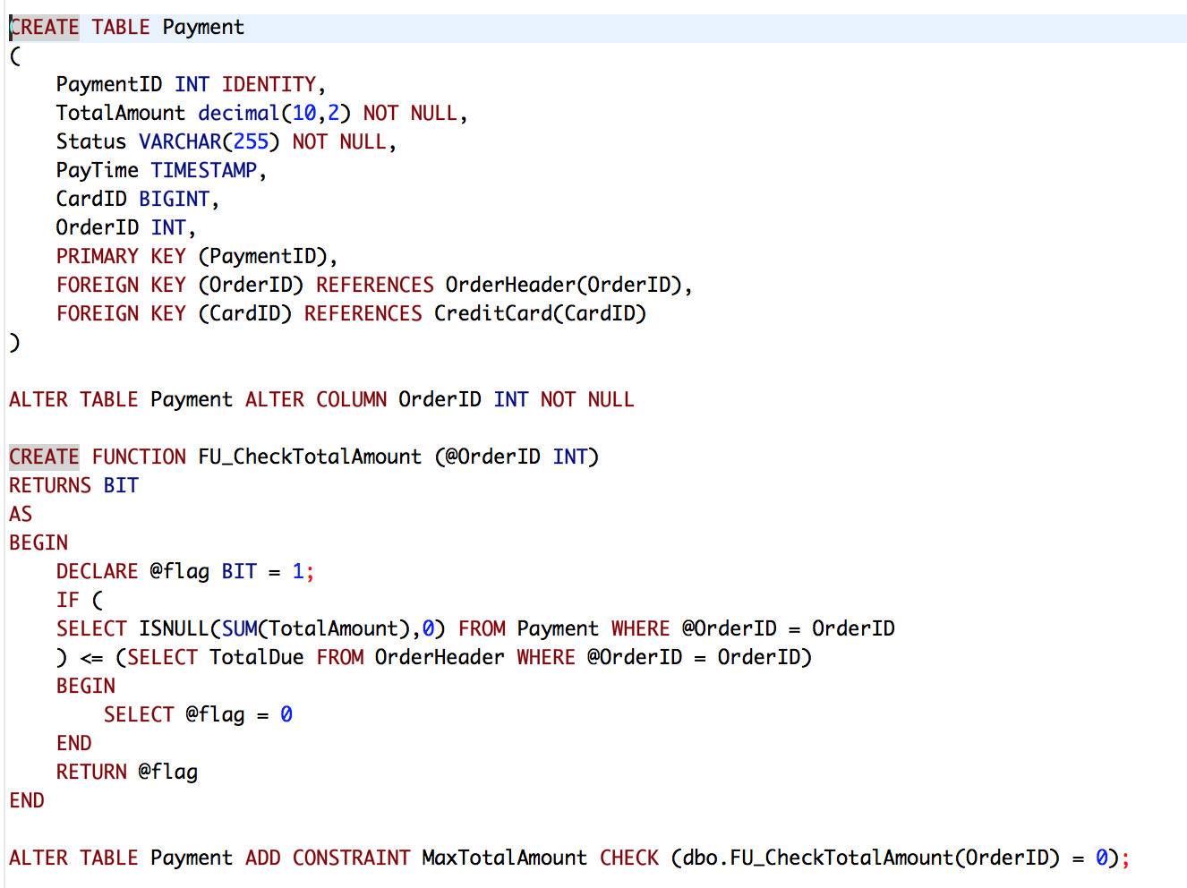
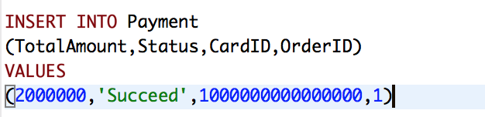
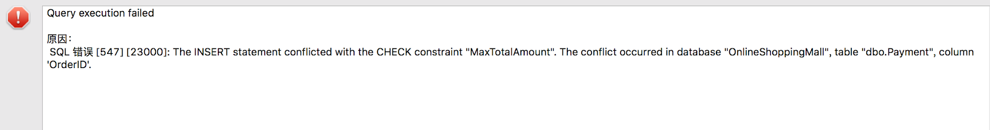
Database Implementation – Table-level Function

Slide 10
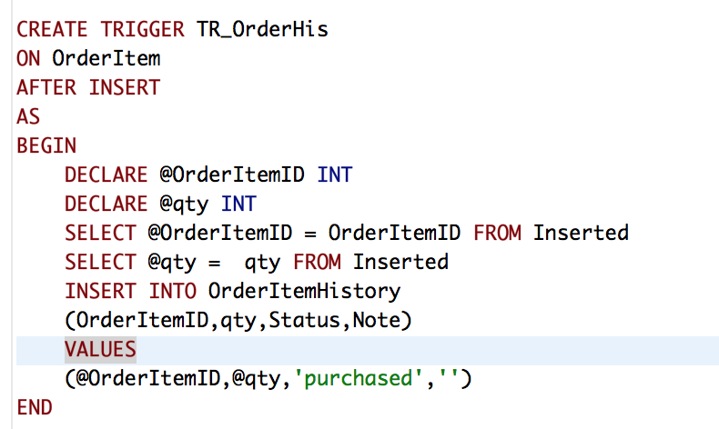
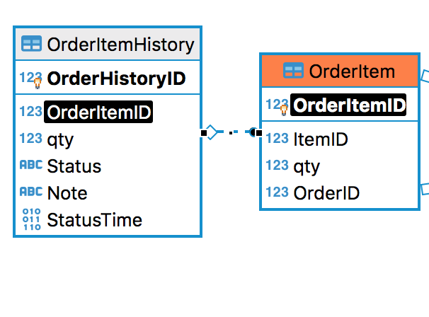
Database Implementation – Trigger

Slide 11
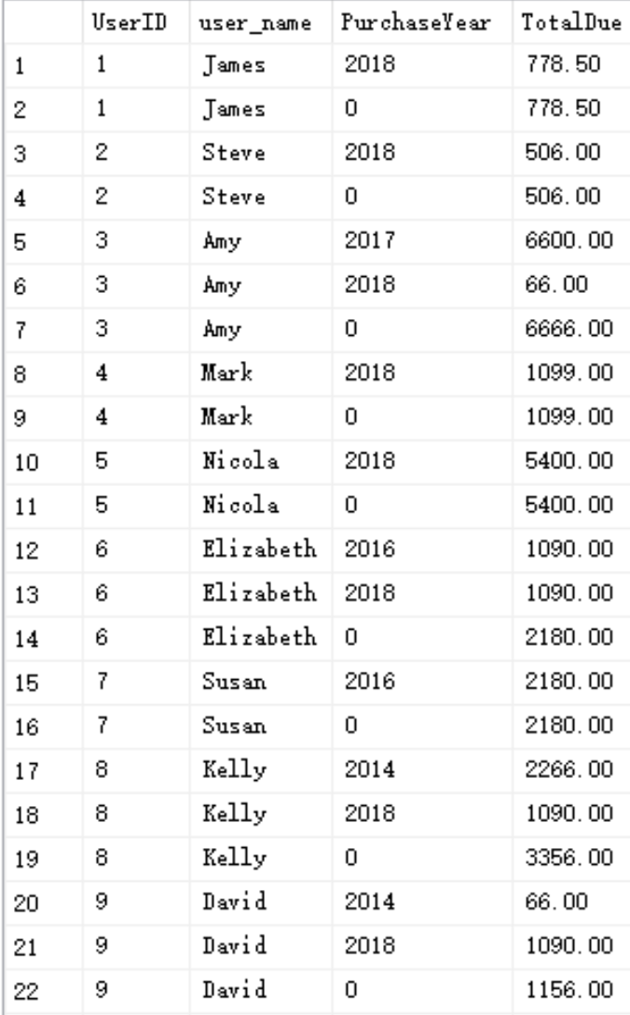
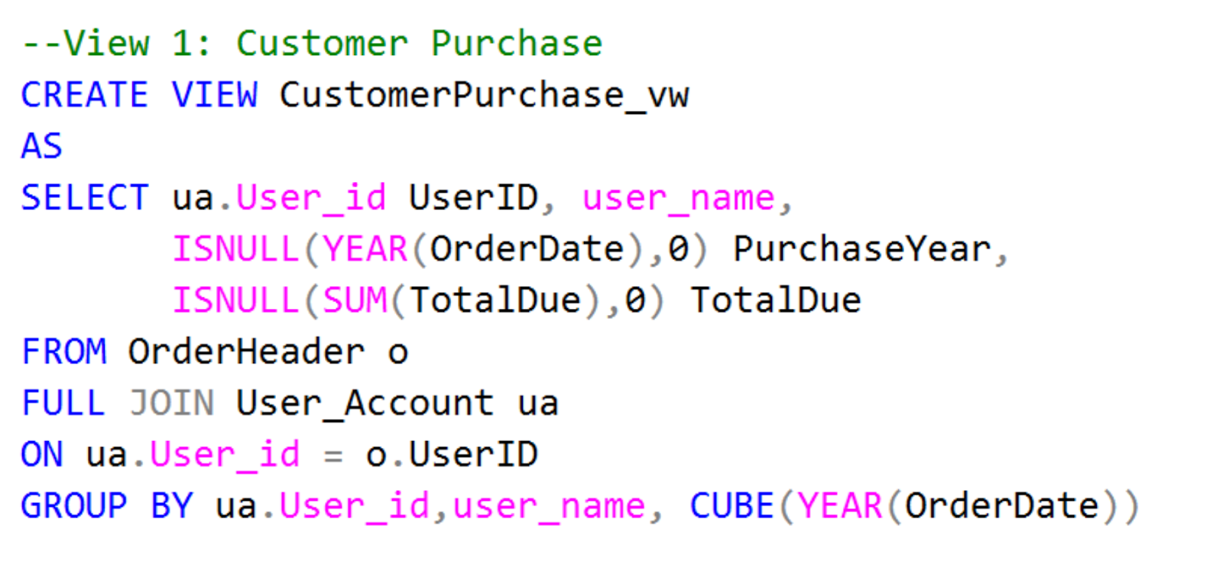
Reporting View 1

Slide 12
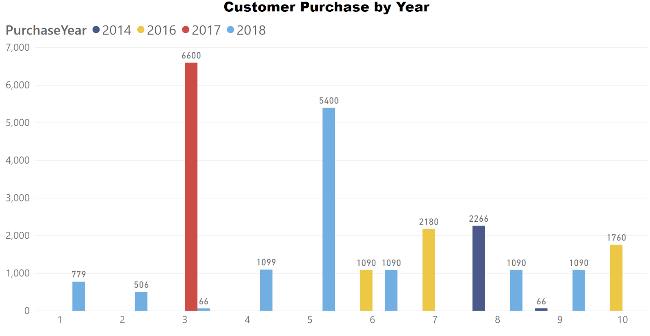
Visualization Example 1
Notes:
Bar chart

Slide 13
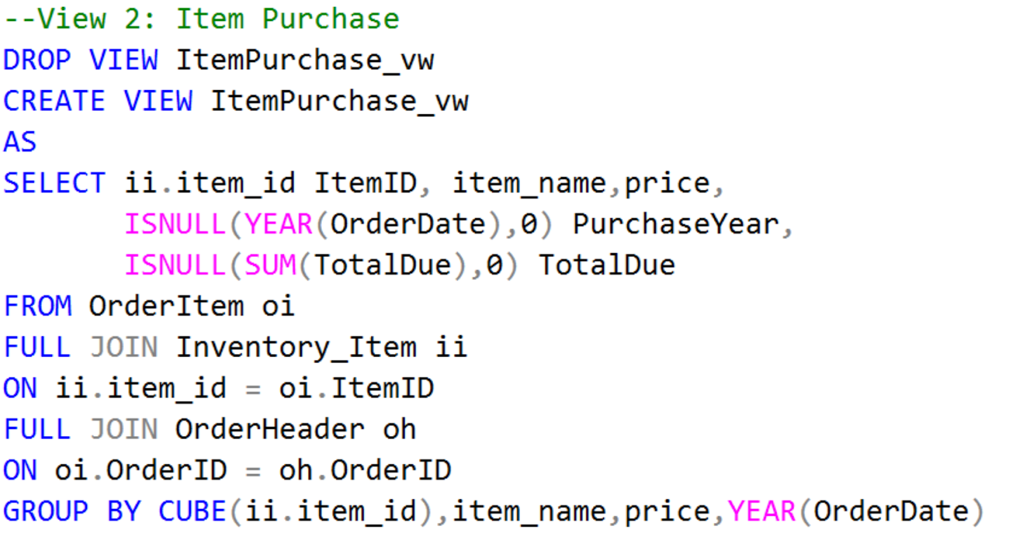
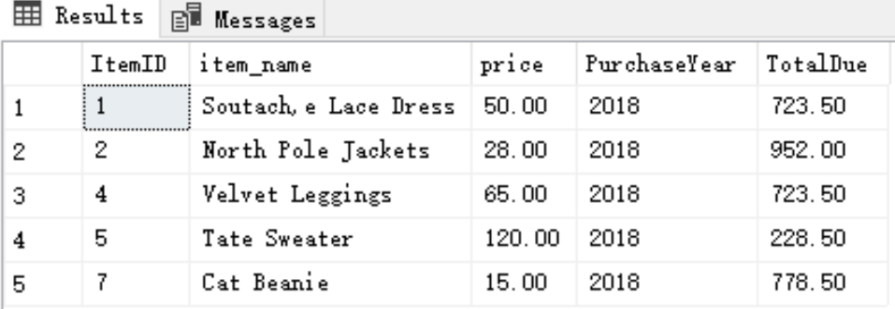
Reporting View 2

Slide 14
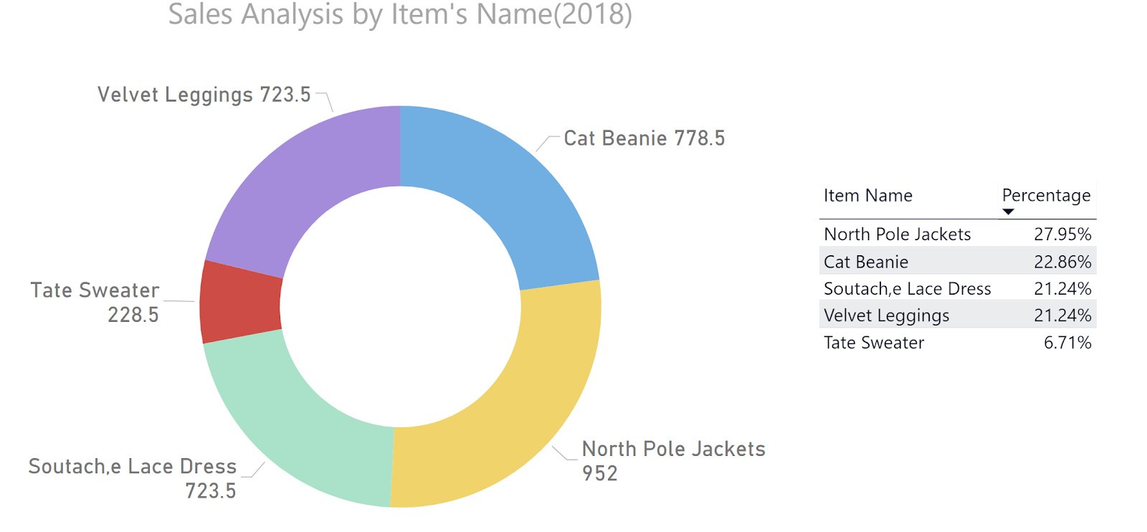
Visualization Example 2
Notes:
Donut chart

Slide 15
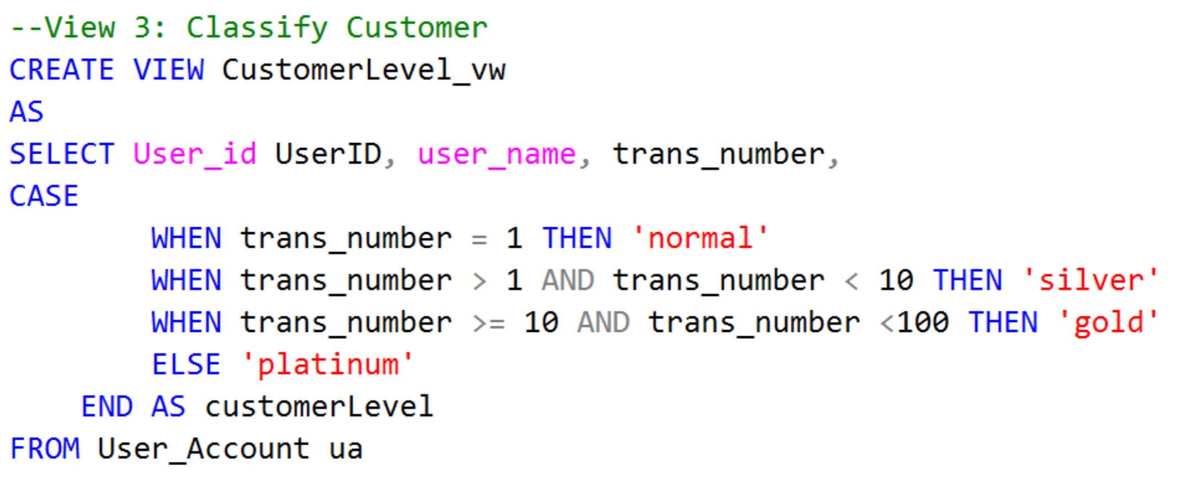
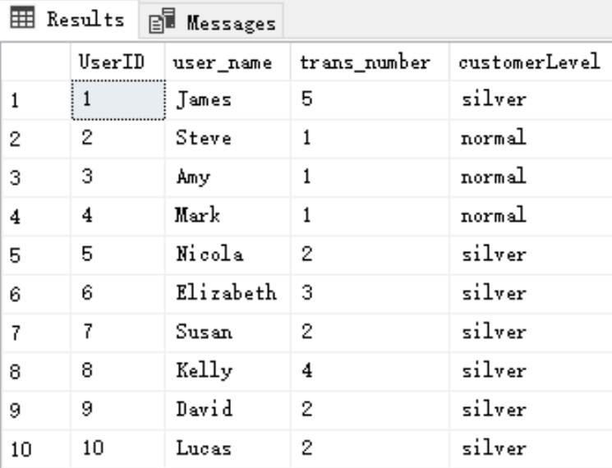
Reporting View 3

Slide 16
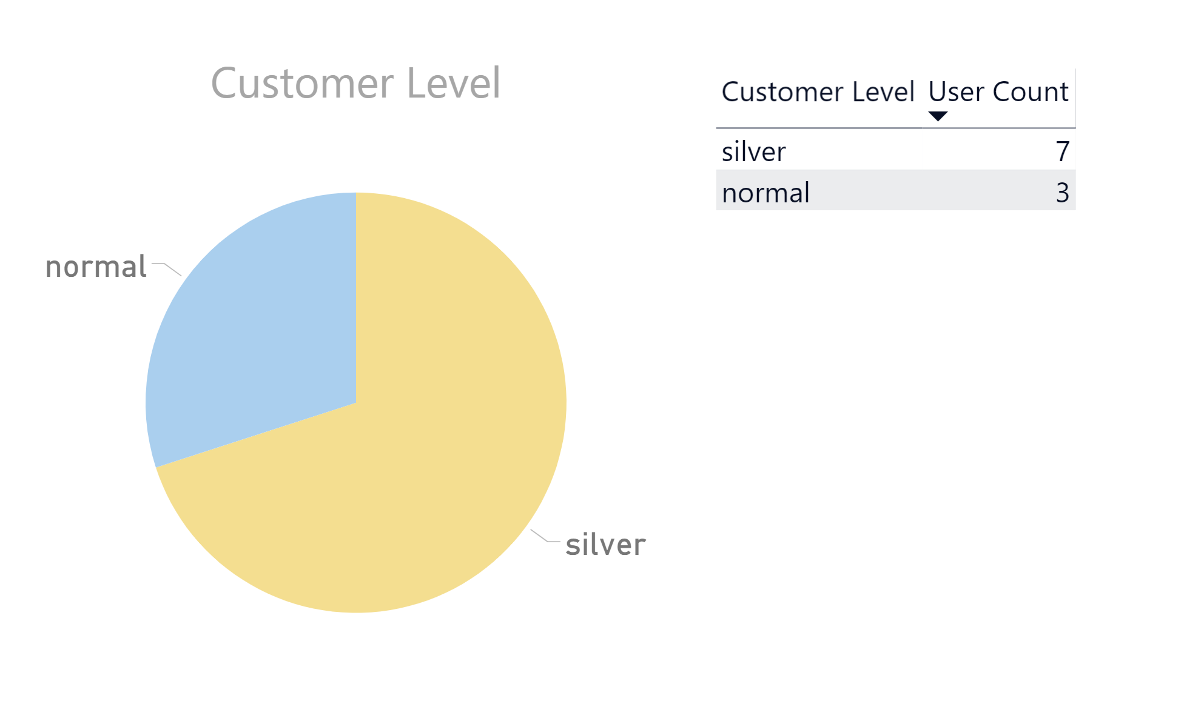
Visualization Example 3
Notes:
Pie chart

Slide 17
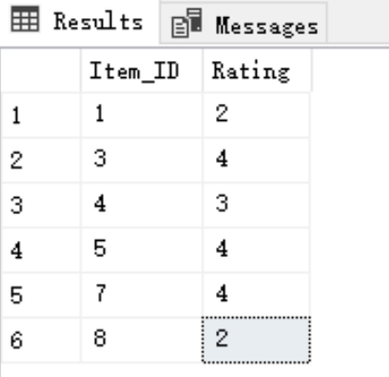
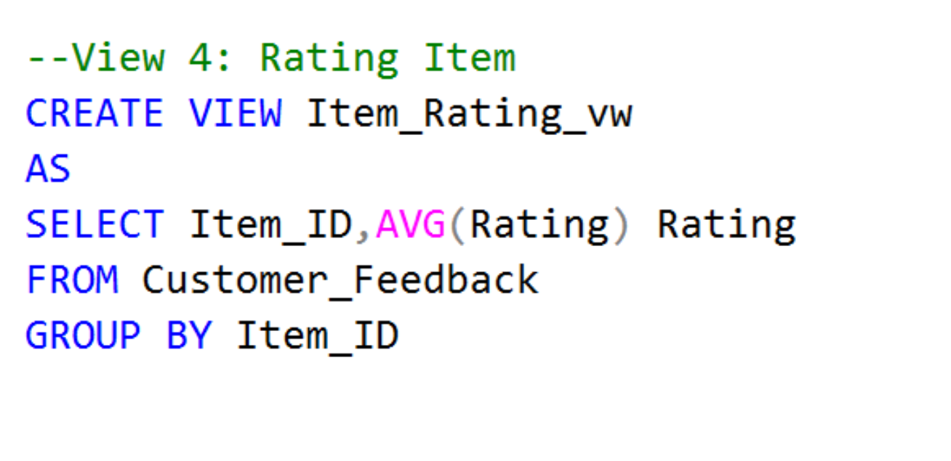
Reporting View 4

Slide 18
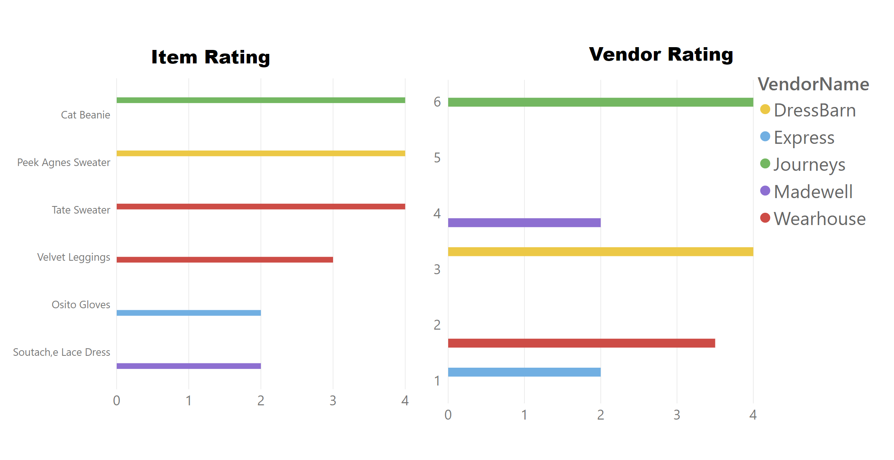
Visualization Example 4
Notes:
Bar chart

Slide 19
Conclusions
1
We presented a database which records online shopping experience
From user information, the order history, inventory shipping details, to online advertisements, the database collects detailed information in analyzing customer shopping preferences
2
3
By analyzing data with SQL queries and presenting in Power BI, we can target specific users for advertisement, understand annual sales

Slide 20

Thank you!
Q & A

